Slide 1


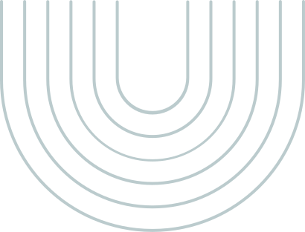
The Weight of Knowledge: Understanding the True Drivers of Obesity
Rani Misra, Cheryl Chiu, Kashfia Sharmin, Abigail Davis
Notes:
Our group did the project on the drivers of obesity.

Slide 2

INTRODUCTION
Notes:
According to the 2020 National Health and Nutrition Examination Survey (NHNES), 41.9% of adults have obesity in the United States (State of Obesity 2022: Better Policies for a Healthier America 2022). Our goal is to determine what factors lead to obesity to raise public awareness of healthy habits in America. We have used data from the Inonu University Health Sciences Non-Interventional Clinic Research Ethics Committee to conduct our research. Utilizing this data can raise awareness of the factors that might contribute to obesity in our community. First, we will provide a broad overview of the data.
https://www.tfah.org/report-details/state-of-obesity-2022/

Slide 3
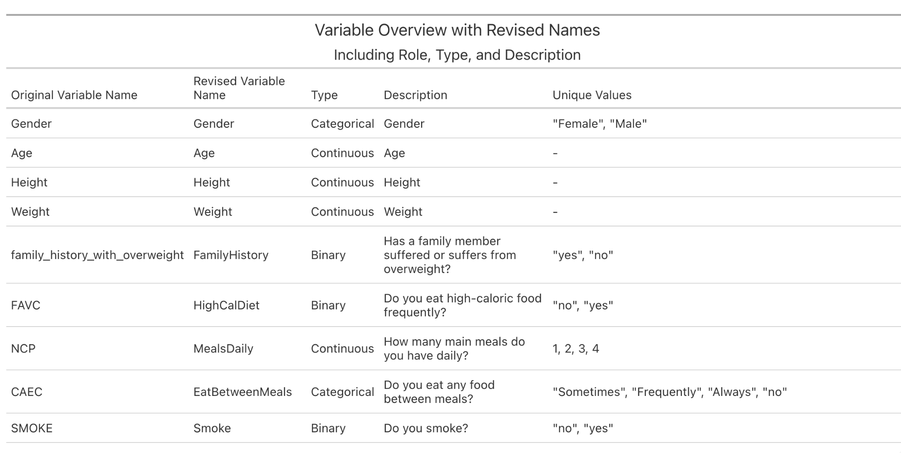
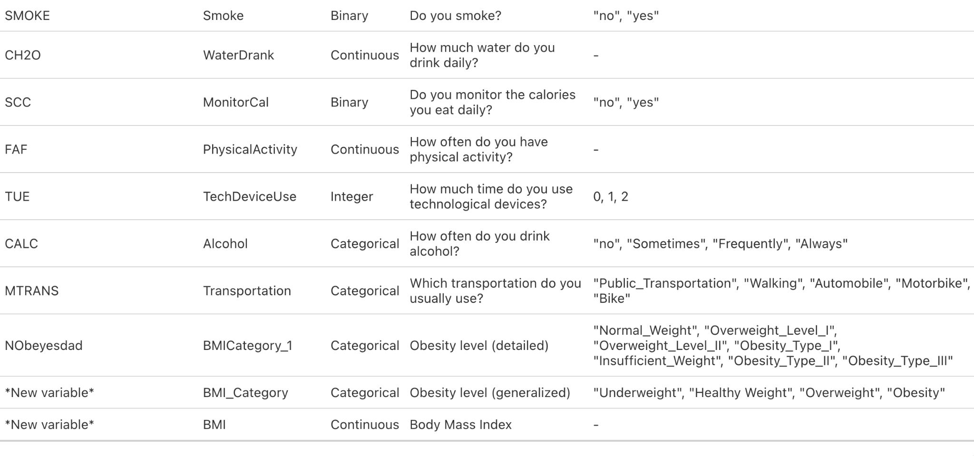
Data Dictionary
500 observations
Obtained from Kaggle
Revise variable names
Added BMI + BMI_Category
Age, MealsDaily, TechDeviceUse:
changed to integers
All binary data changed to “0/1” instead of “no/yes” “female/male”
Added levels to each factor
Table is constructed by gt library in R
Notes:
In this analysis, an open data with ~500 south american participants was obtained from kaggle. The data was later cleaned and revised using R studio. The table here plotted by R STUDIO shows the modifications we made for future analysis. Including calculating BMI, defined BMI categories, changing the variable names, change the binary variables to 0 and 1 for regression calculation, and adding proper levels to each level.
—----------
This investigation included data for the estimation of obesity levels, including the eating habits and physical activity statuses of 498 participants between the ages of 14 and 61 from Barranquilla, Colombia; Lima, Peru; and the City of Mexico, Mexico.
When cleaning the data, we created a BMI and BMI_Category variable calculated by dividing the weight by the square root of the height, and then arranged the labels by 4 levels to better explain our data. Underweight is categorized as having a BMI less than 18.5, Healthy Weight has a BMI between 18.5 and 25, Overweight has a BMI of 25 to 30 and Obesity is categorized by having a BMI of more than 30.
We also changed age, NCP (“How many main meals do you have daily?”) and TUE (“How much time do you use technological devices”) to integer, as they were originally floats. We also changed all of the binary data that were written in characters such as gender, family_history_with_overweight, FAVC (“Do you usually eat high caloric food frequently”), etc, into binary (0/1) values to be able to evaluate them more effectively.

Slide 4
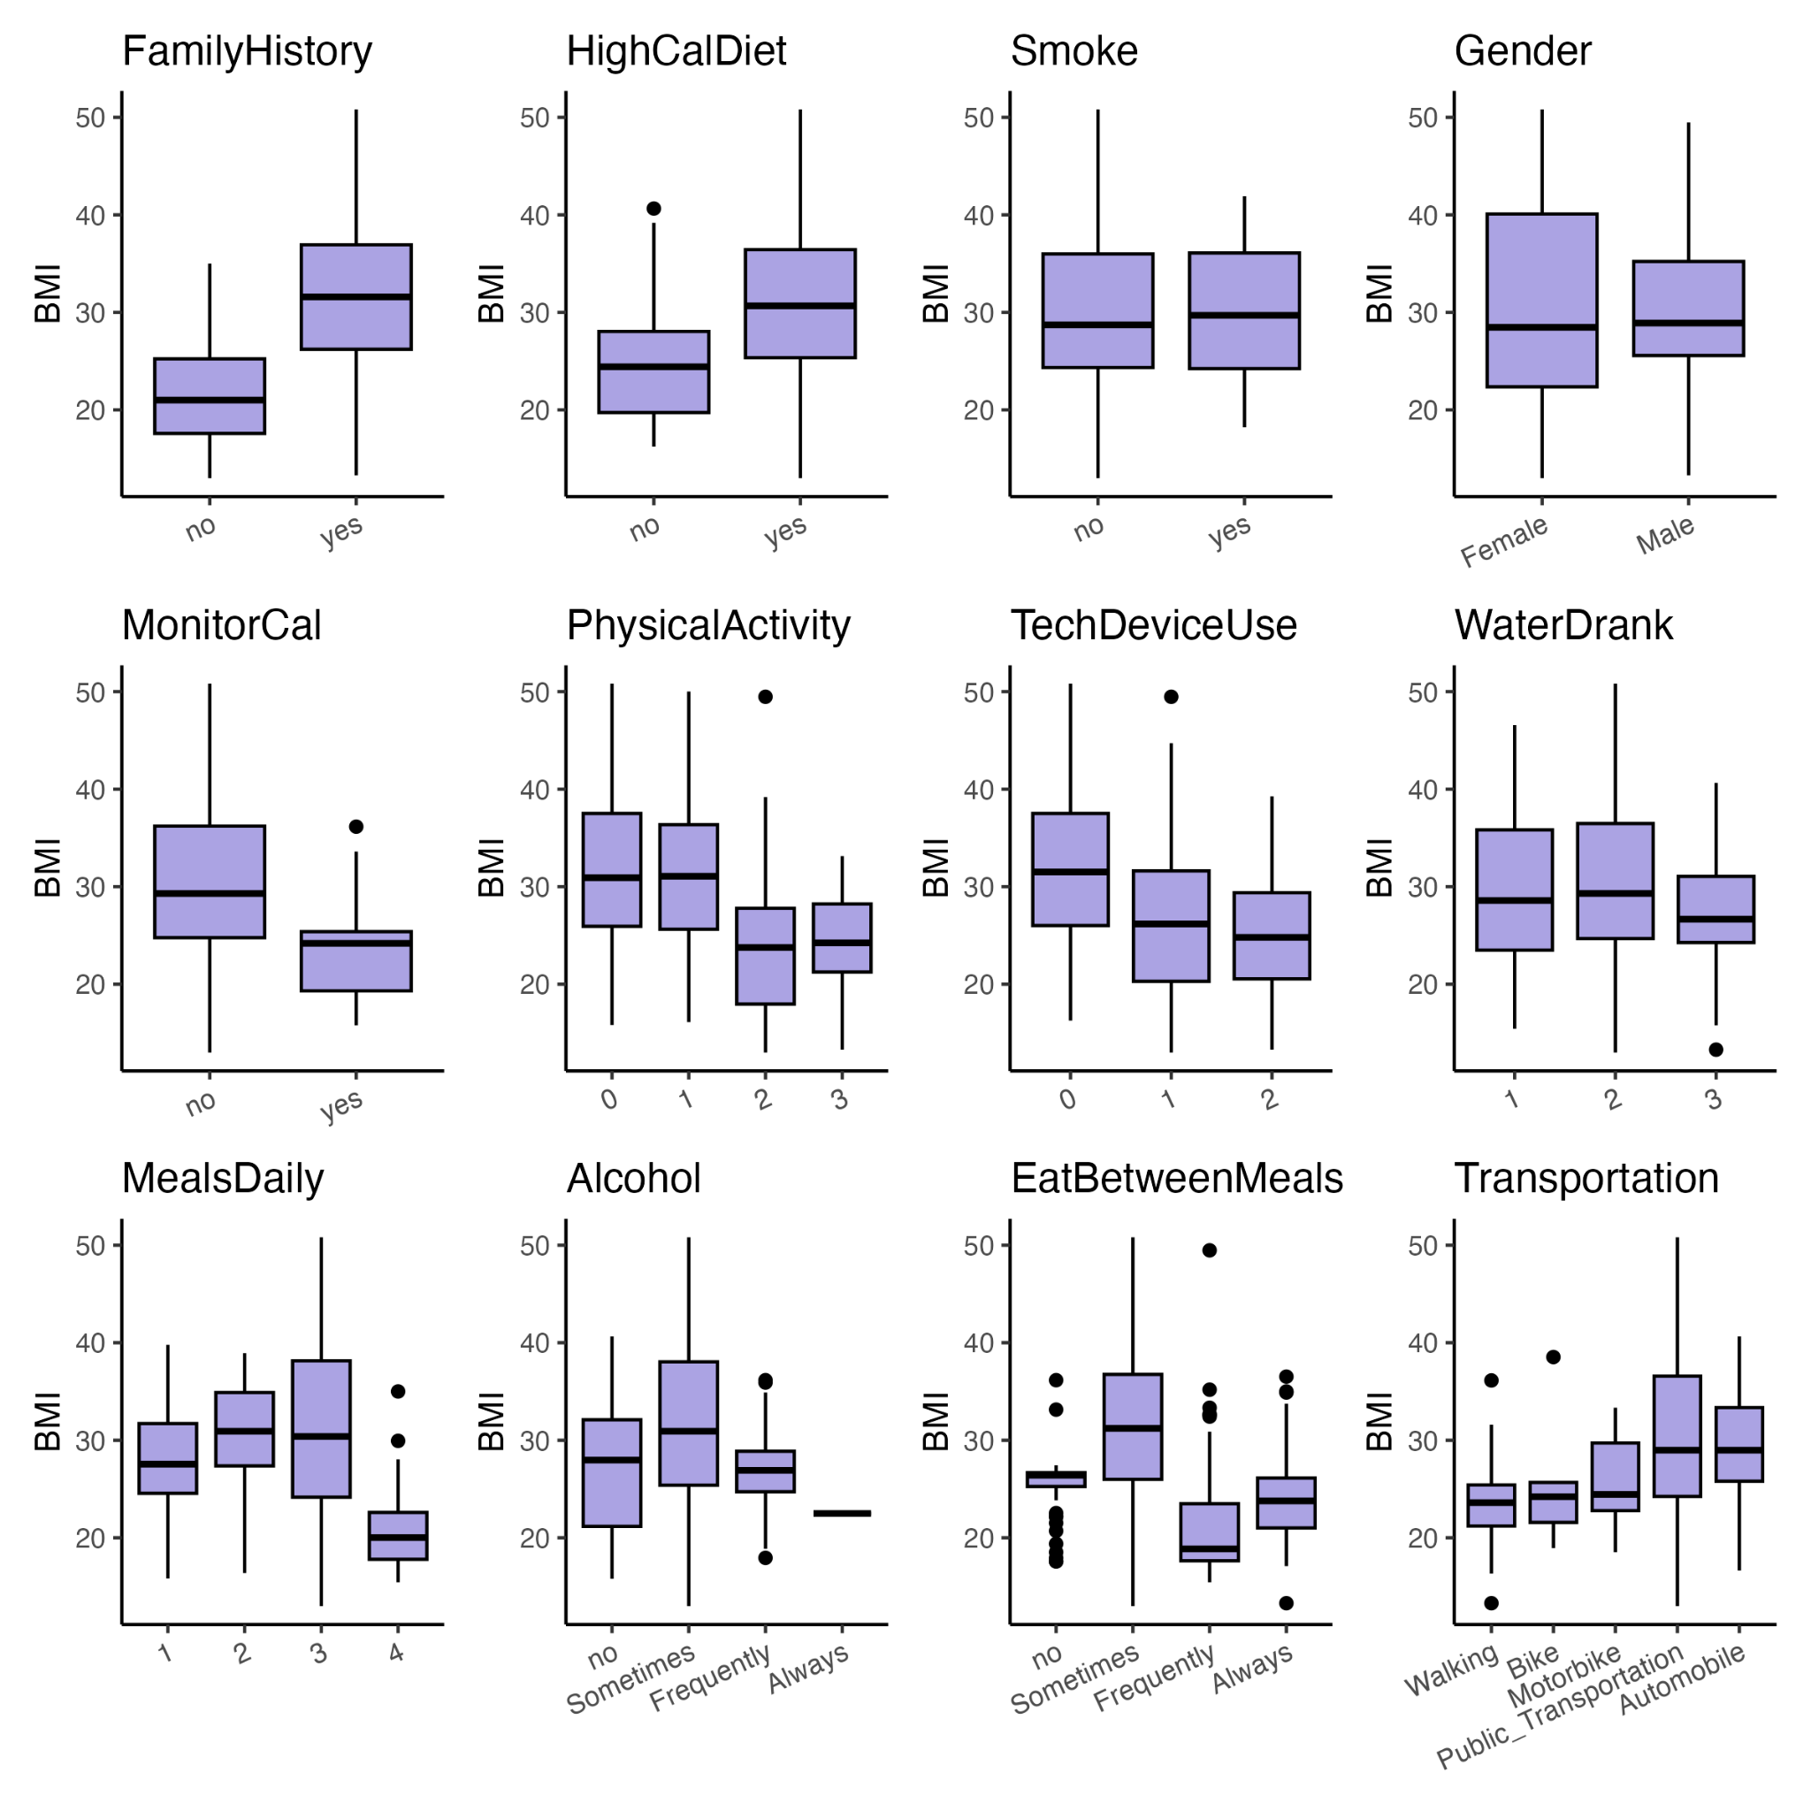
Overview of influence on obesity by each factor
Boxplots showing BMI distributions across each variable, highlighting potential associations and differences in different lifestyle
Notes:
To start our analysis, we wanted an overview of the influence on obesity by each factor provided by the dataset. To do this, we ran a boxplot of all of our variables to see if there’s changes in BMI level. The result shows that that there are some increased BMI trends between obesity and [ - - - - row 1/3 - - - - - ], and a decrease trend in BMI and [----- row 2 —---]. However, the trends here was too complicated to visualize how much influence each factor has to obesity at the same time. As a result, (next page)

Slide 5
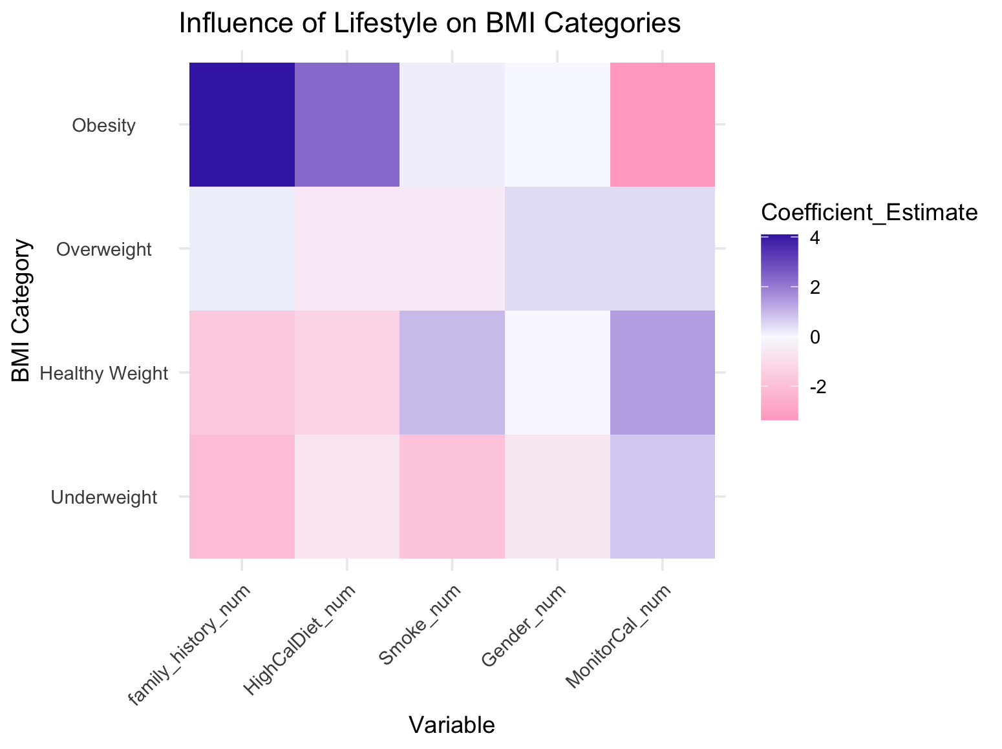
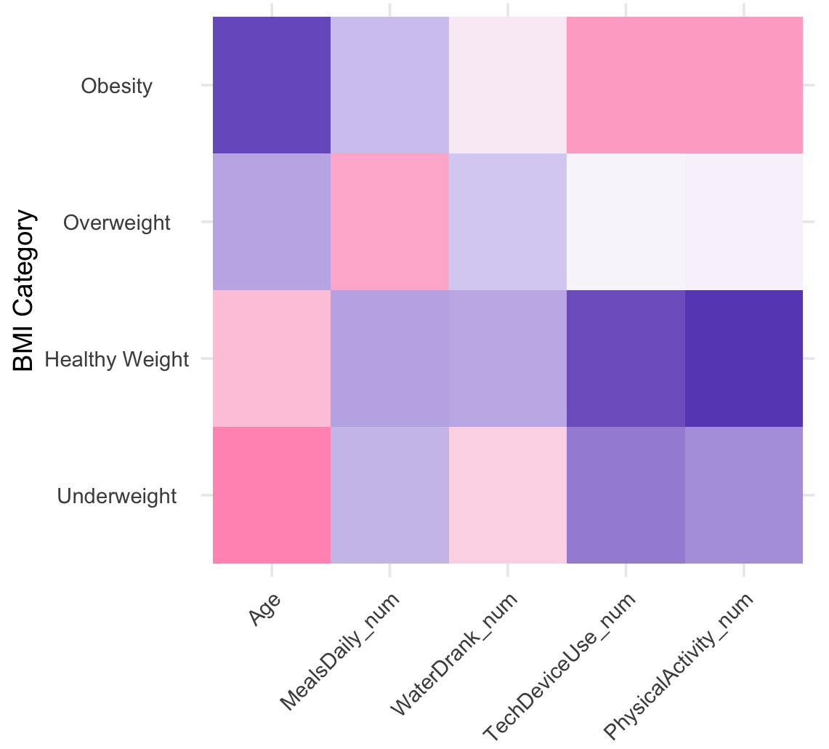
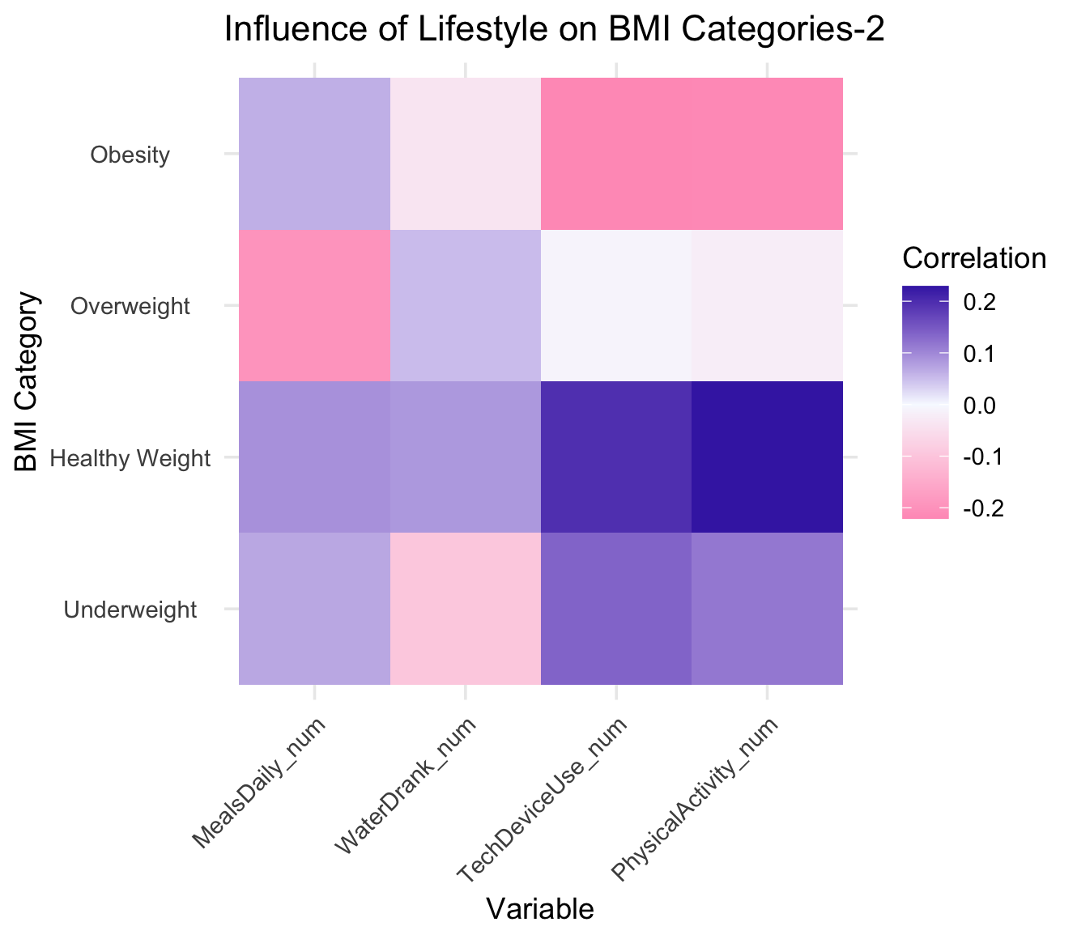
Heatmaps showing influential index of each factor
Family history, high calories diet, age, and meals number has positive/strong influence on obesity level
Binary variable
Continuous variable
Notes:
As a result, we decide to use two regression models and heatmap to visualize every factor at the same time. Here we categorize the factors into two types, one is binary and the other one is continuous. For the binary variable, we used logistic regression to compute the coefficient estimate, the more blue in the heatmap, the more positive influence the factor will be; on the contrast, the more pink, the more negative influence the factor will be. For the continuous variable, we used linear regression and R score to determine the influence.-------- On these heatmap (animation shows up), we arrange the influential level to obesity from positive to negative. And a trend can be observed that family history accounts for the most influence, followed by high-calories diet. Notably, gender seem to be mutual as the index is close to 1. As for the continuous variables, age was shown to be the most influential factor, older age is related to higher obesity rates. Here we also see that higher exercise frequency is correlated to lower obesity rate. The plots shown here are used to bring an overview of all factors, next, we will use tableau to explore the more detailed characteristics in this dataset.

Slide 6
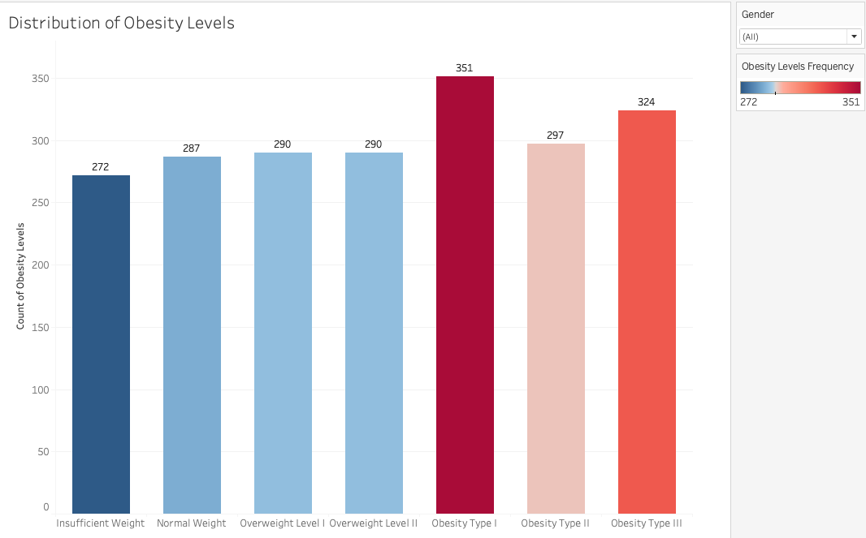
Distribution of Obesity Levels
Type I Obesity has the highest count
Insufficient and Normal Weight has lowest count
Target interventions in this group
Notes:
We plotted the distribution of obesity levels and found that Type 1 Obesity represents the most prevalent category in the dataset, indicating a higher occurrence compared to other obesity types or health classifications analyzed. What is most concerning about this graph, is that normal weight has the second lowest count indicating an epidemic of obesity. This finding suggests a need to focus resources and interventions targeting individuals in this category to address underlying health risks associated with obesity.

Slide 7
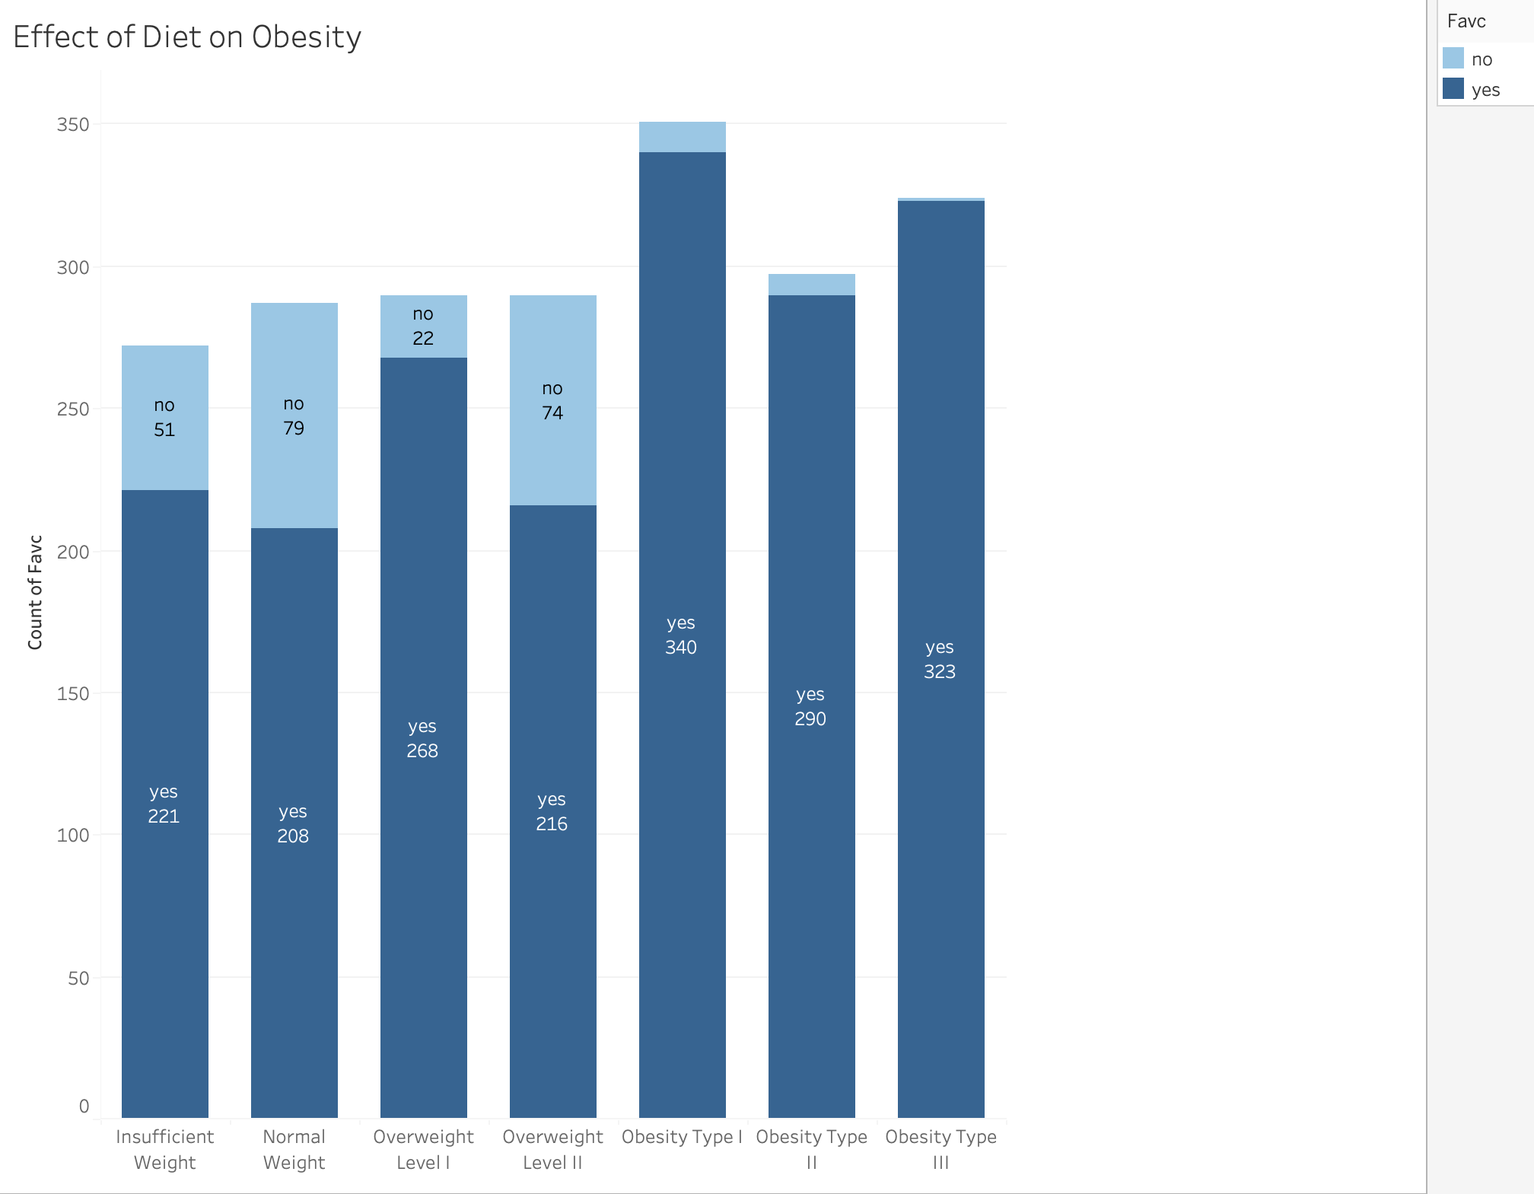
Effect of Diet on Obesity
FAVC: “Do you eat high calorie food frequently”
Obesity Type I has the highest frequency
Insufficient weight & eat higher calorie food more often may be due to metabolism.
Notes:
This plot illustrates the relationship between diet and obesity levels using the FAVC variable, which measures whether or not the respondent eats high calorie food frequently. The data reveals several interesting patterns:
Individuals classified as Obesity Types I, II, and III report consuming high-calorie foods most frequently. This finding aligns with the understanding that excessive calorie intake is a significant contributing factor to obesity.
Interestingly, individuals with insufficient weight consume high-calorie foods more often than those in the overweight level II category.These people may have higher metabolic rates, often associated with greater physical activity levels or other physiological factors, allowing them to consume more calories without gaining excess weight. Understanding these dynamics is essential for designing effective interventions and tailor strategies that consider both dietary habits and individual metabolic characteristics.

Slide 8
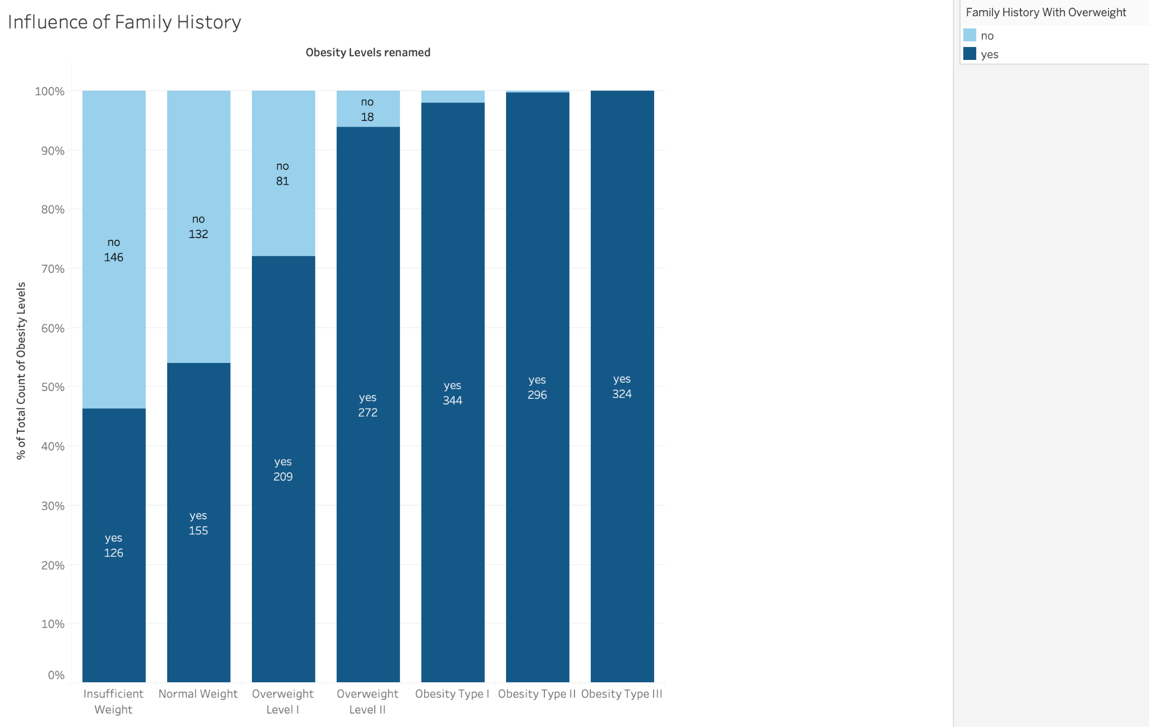
Influence of Family History
People with family history of obesity has highest chances of being obese
Does not take into consideration environment
Notes:
People with a family history of obesity show the highest likelihood of being classified as obese. However, this doesn’t consider the multifaceted nature of obesity, where both genetic predisposition and environmental influences play critical roles. While family history is a significant risk factor, it is not necessarily the most influential. Combining genetic insights with lifestyle assessments can lead to personalized strategies for reducing obesity risk, emphasizing early intervention in individuals with a family history.

Slide 9
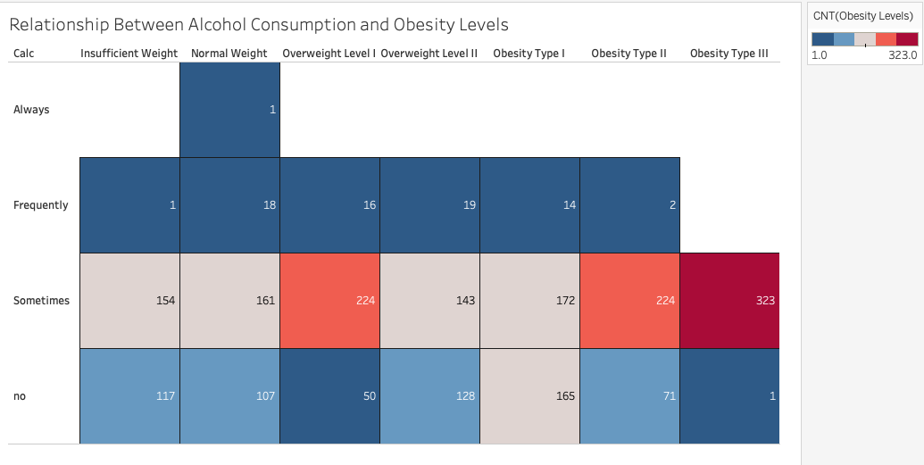
Effects of Alcohol Consumption
“Sometimes” drinking is most common across all obesity levels
Highest frequency: Obesity Type III for “Sometimes”
Notes:
The heatmap shows the frequency distribution of alcohol consumption habits across different obesity levels. The most dominant category is individuals with Obesity Type III, who show the highest counts for “Sometimes” drinking alcohol with a frequency of 323. The “Sometimes” category is consistently popular across all obesity levels, and might point to a cultural or behavioral norm, but its frequency may correlate with obesity levels. According to Kokole et al. (2021), the three countries in which this data was pulled from, Columbia, Mexico, and Peru, alcohol consumption risk factor for death and disability ranked high (5th and 6th respectively). The findings from our chart as well as the findings from Kokole’s research shows that these three countries could benefit from implementation of measures to decrease drinking.

Slide 10
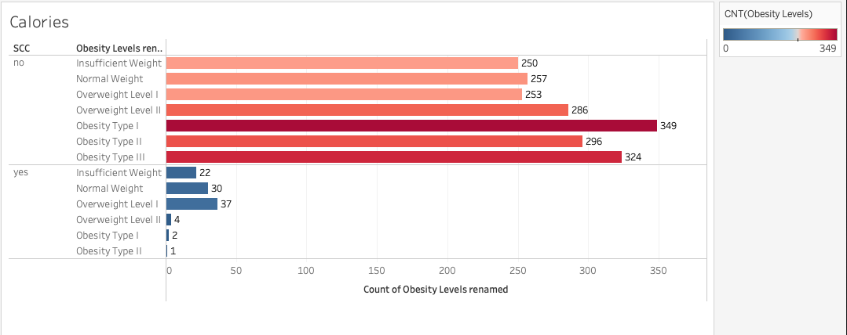
Tracking Calories
Most respondents do not track calorie intake
Does not support goal of healthy habits
Notes:
The SCC variable determines whether or not the respondent tracks their calorie intake or not. From the chart, we can tell that majority of respondents do not track their intake in calories. However, based on the respondents who do, we can tell that it tends to be the respondents with the lower weight. We can conclude that because overweight level 1 has the highest use of monitoring, this could be because they would like to lose weight by monitoring their calorie intake. However, tracking calories has a slippery slope in causing eating disorders leading to insufficient weight. According to Levinson et al. (2017), using calorie tracking apps such as MyFitnessPal, 73% of app users stated that the app has contributed to their eating disorder. So while tracking calories may support respondents who would like to lose weight in the obese and overweight population, we do not support using these apps based on our project’s goal of healthy habits

Slide 11
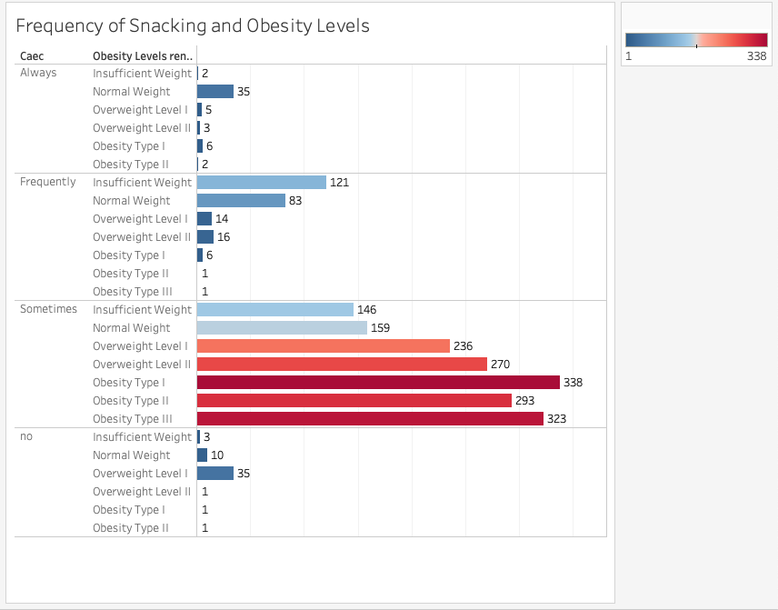
Eating between Meals
Frequency of eating between meals by weight and obesity levels.
Obese individuals dominate the Sometimes category.
Normal and underweight groups are less represented.
Notes:
This chart shows how often individuals eat between meals, grouped by weight and obesity levels. Individuals with Obesity_Type_I, Obesity_Type_II, and Obesity_Type_III dominate the Sometimes category, indicating a higher frequency of snacking among obese individuals. Normal and underweight individuals have lower counts across all eating frequency categories.

Slide 12
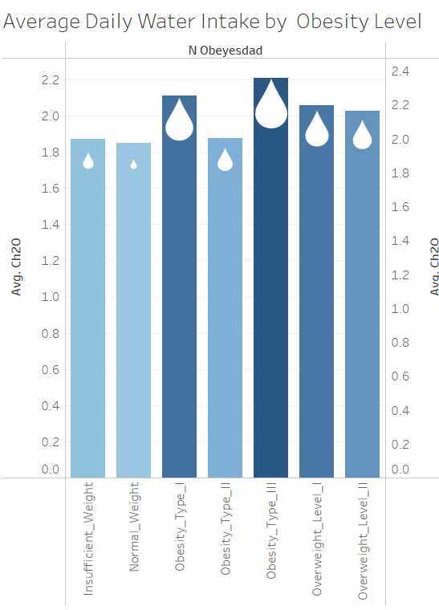
Water Intake
Obesity Type III has the highest average water intake.
Obesity Type I and II follow.
Overweight individuals (Level I and II) consume slightly less water than obese I and III groups.
Normal Weight and Insufficient Weight groups have the lowest water consumption.
Notes:
This chart shows the average water intake across different weight and obesity categories.
The highest water consumption is observed among individuals classified as Obesity Type III, likely linked to increased hydration needs or healthcare advice for weight management.
Obesity Types I and II also have notable water intake levels, suggesting an overall higher awareness of hydration among obese individuals.
Overweight individuals consume less water on average compared to the obese categories, with Normal and Insufficient Weight groups drinking the least.
Lower water intake in the Normal and Insufficient Weight categories may reflect lifestyle factors, lower body mass, or fewer recommendations for hydration.

Slide 13
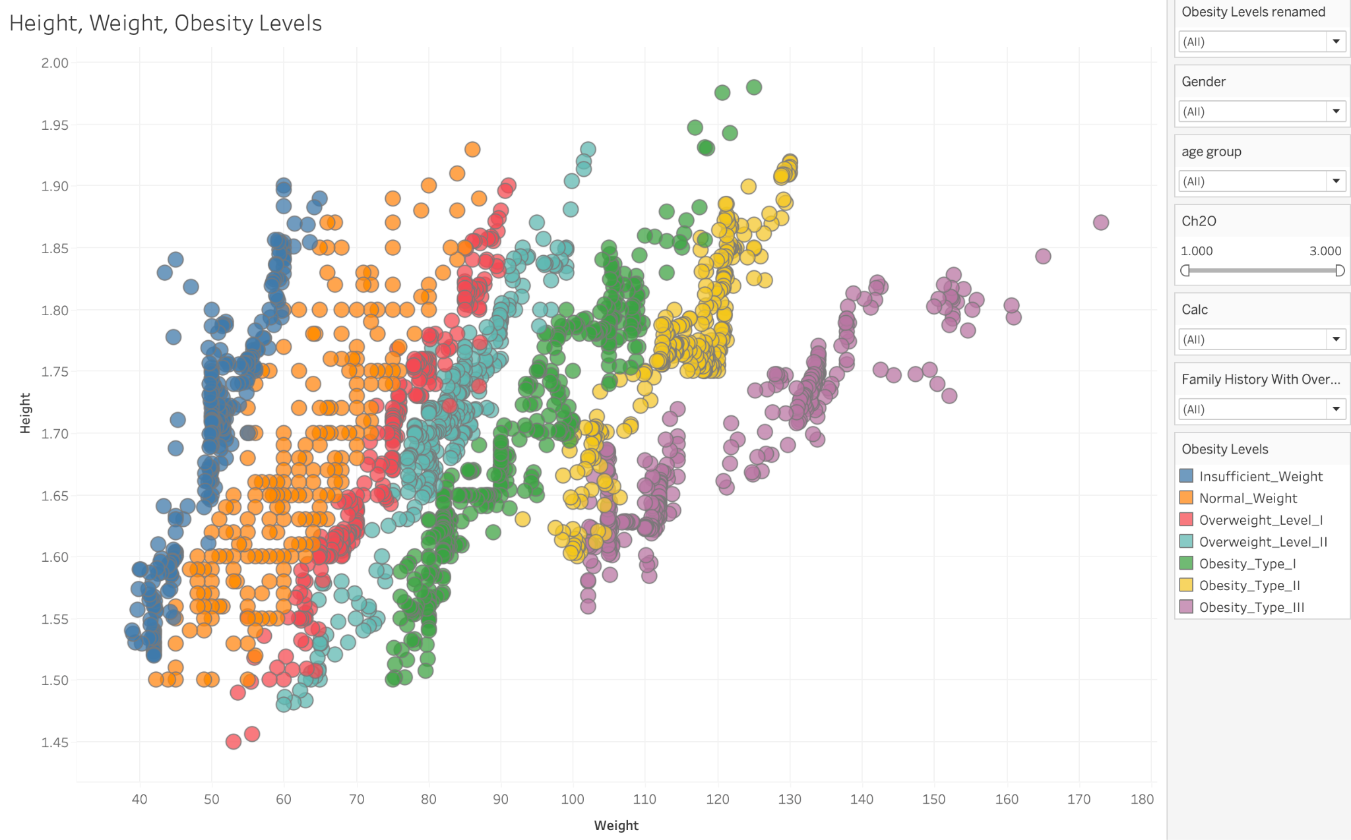
Weight vs. Height
Strong positive correlation between weight and height across all categories.
Obesity Types I, II, and III dominate the upper ranges of weight and are moderately distributed in height.
Normal Weight and Insufficient Weight groups cluster at the lower weight ranges.
Overweight and obese groups have more variation in weight and height compared to Normal/Insufficient Weight.
Notes:
This scatter plot illustrates how weight and height vary across different obesity and weight categories.
There is a clear positive correlation – as height increases, weight also tends to rise. This trend is expected and aligns with basic anthropometric (study of human proportion) patterns.
Obesity Types I, II, and III dominate the upper weight ranges. Interestingly, individuals in these categories are distributed across a moderate height range, indicating that obesity may not be as height-dependent as weight.
Normal Weight and Insufficient Weight individuals are tightly clustered in the lower ranges of weight and height. These groups show less variability, likely due to physiological constraints.
The separation of groups along weight and height axes highlights the distinctiveness of obesity levels. This could reflect differences in lifestyle, genetic predisposition, or environmental factors influencing weight.

Slide 14
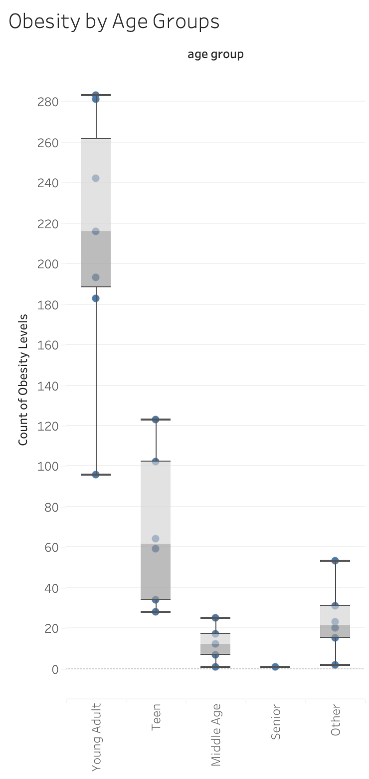
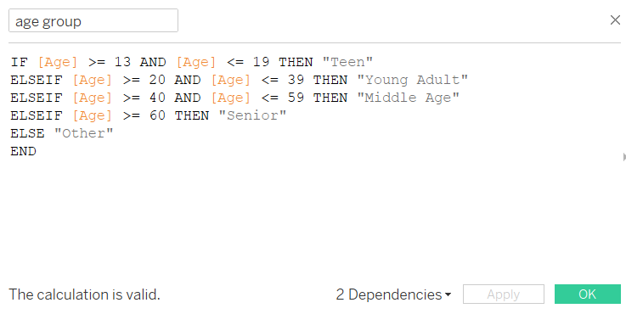
Obesity by Age Groups
Young adults and Teens have the highest counts of obesity
Middle Age and Senior have the lowest counts of obesity
Notes:
To determine obesity counts by age group, we first had to create a calculated field. In this calculated field, we grouped ages 13-19 as ‘Teens’, Ages 20-39 as “young adult”, Ages 40 to 59 as ‘middle age’ and 60 and above as ‘seniors’. This allowed us to view the trends of young adult and teens having the highest counts of obesity and middle age and seniors having the lower rates. This can help us determine which age groups intervention should be targeted for.

Slide 15

CONCLUSION
Key factors: family history, high-calorie diet, age, meal frequency
Type I obesity is most common
Insights: meal frequency, water intake, and alcohol habits
Notes:
Key findings show that family history, high-calorie diet, age and number of meals to obesity, with Type I obesity being the most common. Patterns in meal frequency, water consumption and alcohol habits offer insights for health strategies. These findings emphasize the importance of addressing obesity through multifaceted approach that considers lifestyle behaviors and cultural and behavioral norms to pave the way for effective public health strategies and interventions. By analyzing key factors contributing to obesity using statistical and clustering methods, our conclusions from this dataset can help state health and human service departments develop targeted public awareness campaigns. These initiatives will aim to educate high-risk populations and the general public on the behaviors, environmental influences, and systemic factors associated with obesity, enabling more effective intervention strategies.

Slide 16
Citations
Warren, M., Beck, S., & West, M. (2022). The state of obesity: 2022 Better policies for a healthier America. Trust for America’s Health. https://www.tfah.org/report-details/state-of-obesity-2022/
Levinson, C. A., Fewell, L., & Brosof, L. C. (2017). My Fitness Pal calorie tracker usage in the eating disorders. Eating behaviors, 27, 14-16. https://pmc.ncbi.nlm.nih.gov/articles/PMC5700836/#:~:text=Recent%20research%20has%20shown%20that,associated%20with%20eating%20disorder%20pathology.
Kokole, D., Mercken, L., Jané-Llopis, E., Natera, G., R., Arroyo, M., Medina, P., Pérez-Gómez, A., Mejía-Trujillo, J., Piazza, M., Bustamante, I., V., O’Donnel, A., Kaner, E., Gual, A., Lopez-Pelayo, H., Schulte, B., Manthey, J., Rehn, J., Anderson, P., & Vries, H., D. (2021). Perceived appropriateness of alcohol screening and brief advice programmes in Colombia, Mexico, and Peru and barriers to their implementation in primary health care - a cross-sectional survey. Primary Health Care Research and Development, 22, e4.https://pmc.ncbi.nlm.nih.gov/articles/PMC8057507/

